Slide 1
Correcting Misinformation in the Clinic: A New Course for Medical Students
Rachel Brill
Stacy Brody
Ian Roberts
Notes:
1

Slide 2
Identifying the Problem
Lack of training on misinformation, reported by physicians
A lot of (mis)information to sort through
Build self-confidence, communication skills, and information literacy

Slide 3
The New Module @ GW SMHS
184 first year medical students (22 small groups of 8-9 students)
Research guide go.gwu.edu/correctingMisinformation
Learning objectives:
Identify misinformation
Practice SIFT: Stop. Investigate. Find. Trace.
Conducted in November 2022
Notes:
3

Slide 4
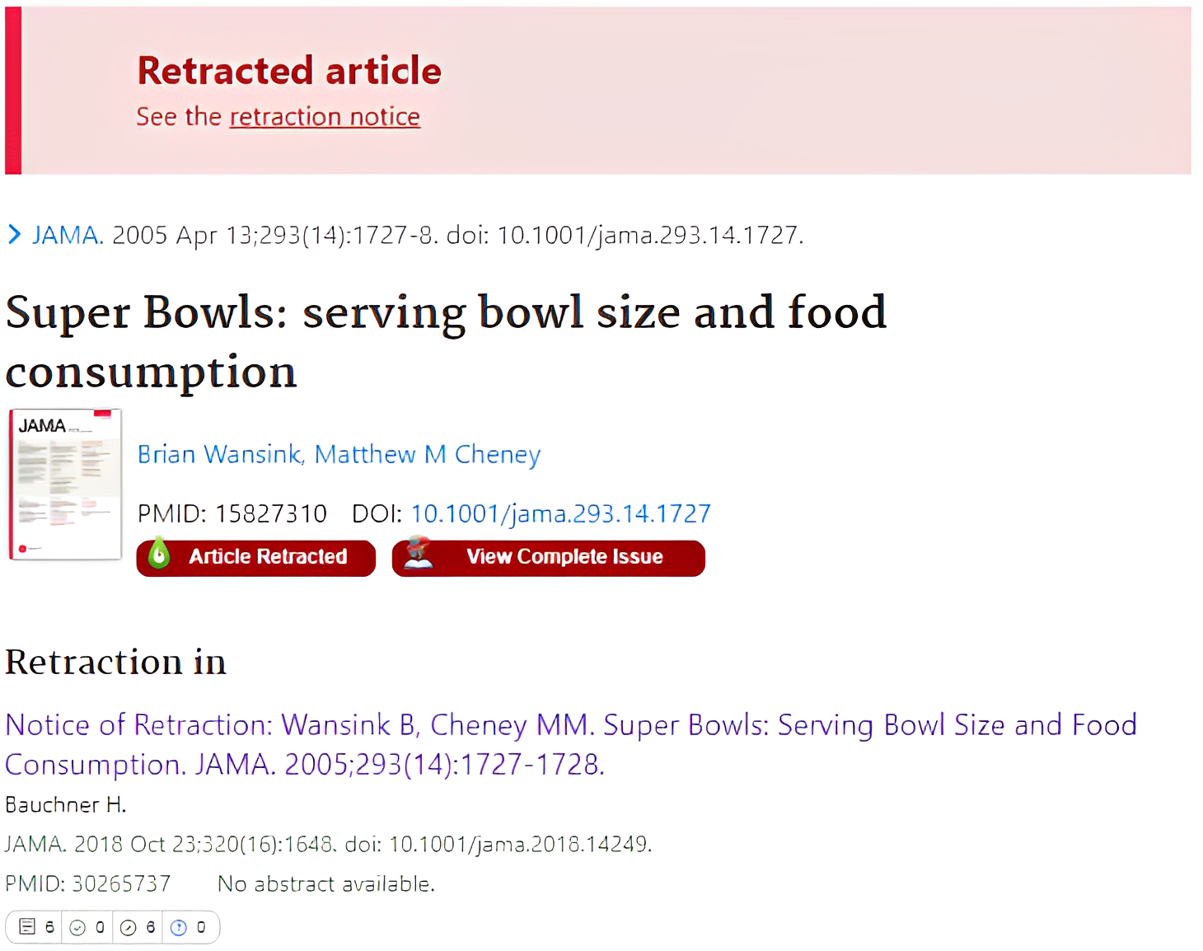
Practicing SIFT
Find: MedlinePlus: Nutrition
Trace: Wansink’s studies have been retracted or questioned.​
Stop: This is a CNN article; David S. Martin reports on research by Brian Wansink
Investigate: Martin, senior producer, CNN Medical News, does not critique or cite studies

Slide 5
Conclusions and Future Research
High engagement reported
Expand to include communication skills with standardized patients
Participant evaluation
Notes:
5

Slide 6
Citations
Akers, K. G., Hu, E., Rehman, N., Yun, H. J., Hoofman, J., Monconduit, R., & Mendez, J. (2022). Building First-Year Medical Students’ Skills in Finding, Evaluating, and Visualizing Health Information Through a “Debunking Medical Myths” Curricular Module. Medical Science Educator, 32(2), 309–313. https://doi.org/10.1007/s40670-022-01541-w
Caulfield, M. (2019, June 19). SIFT (The Four Moves). Hapgood. https://hapgood.us/2019/06/19/sift-the-four-moves/
Moore, C. F., Sabino, V., Koob, G. F., & Cottone, P. (2017). Pathological Overeating: Emerging Evidence for a Compulsivity Construct. Neuropsychopharmacology : official publication of the American College of Neuropsychopharmacology, 42(7), 1375–1389. https://doi.org/10.1038/npp.2016.269
Norton, Z. S., Olson, K. B., & Sanguino, S. M. (2022). Addressing Vaccine Hesitancy Through a Comprehensive Resident Vaccine Curriculum. MedEdPORTAL : the journal of teaching and learning resources, 18, 11292. https://doi.org/10.15766/mep_2374-8265.11292
Roberts, I. (2023, January 23). Correcting Misinformation with Patients: Home. Himmelfarb Health Sciences Library Research Guides. https://guides.himmelfarb.gwu.edu/correcting-misinformation
Shajahan, A., & Pasquetto, I. V. (2022). Countering Medical Misinformation Online and in the Clinic. American family physician, 106(2), 124–125.

Slide 7
Further reading
Bautista, J. R., Zhang, Y., & Gwizdka, J. (2021). US Physicians' and Nurses' Motivations, Barriers, and Recommendations for Correcting Health Misinformation on Social Media: Qualitative Interview Study. JMIR public health and surveillance, 7(9), e27715. https://doi.org/10.2196/27715
Pasquetto, I. V., Shajahan, A., Winner, D., & Testa, L. V. (2022). MisinfoRX: A Toolkit for Healthcare Providers. MisinfoRX. Retrieved February 27, 2023, from https://misinforx.com/download/
Southwell, B. G., Wood, J. L., & Navar, A. M. (2020). Roles for Health Care Professionals in Addressing Patient-Held Misinformation Beyond Fact Correction. American Journal of Public Health, 110(S3), S288–S289. https://doi.org/10.2105/AJPH.2020.305729
Sullivan, M. C. (2019). Why librarians can’t fight fake news. Journal of Librarianship and Information Science, 51(4), 1146–1156. https://doi.org/10.1177/0961000618764258

Slide 8
Acknowledgements
Himmelfarb Librarian Instructors for testing our SIFT case studies and delivering the session to their small groups
Himmelfarb Library Leadership for encouraging us to work on this project and reviewing session materials

