Slide 1
From Digital Commons to Alma/Primo: A Systems Interoperability Project
Sara Hoover, Metadata and Scholarly Publishing Librarian, Himmelfarb Health Sciences Library, The George Washington University
JoLinda Thompson, Associate Director (Interim), Library Operations & Systems Librarian, Himmelfarb Health Sciences Library, The George Washington University

Slide 2
Overview
04
Next Steps
What we learned and next steps for future research in this area
Background
Discuss how the Himmelfarb Health Sciences library added institutional repository content from our Doctor of Nursing Practice (DNP) Project collection into our instance Alma/Primo VE
01
03
How?
Project logistics and workflow design
Why?
Highlight reasons for including grey literature in our discovery system/why DNP projects were a good fit
02

Slide 3
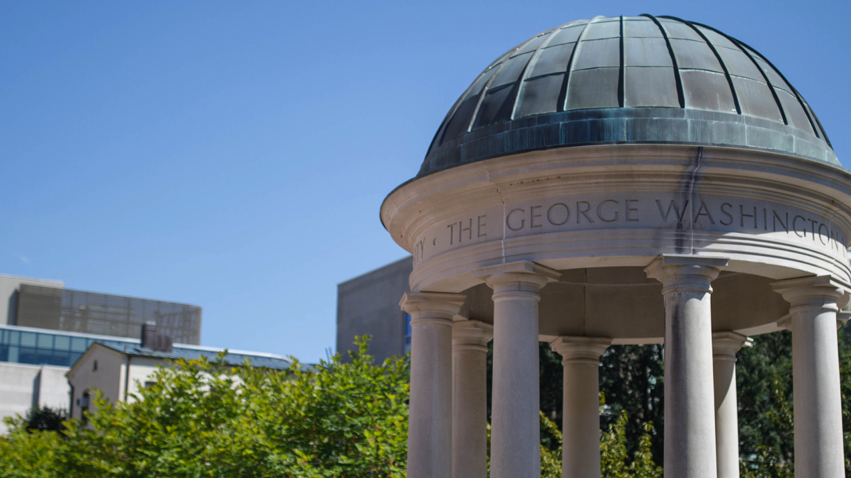
Himmelfarb Health Sciences Library
Health Sciences Library for the George Washington University in Washington D.C.
Serve the School of Medicine and Health Sciences, the Milken Institute School of Public Health, and the School of Nursing
R1 institution
©The George Washington University

Slide 4
A tale of two systems…
Digital Commons
(OA repositories)
Alma /
Primo VE
(Discovery systems)

Slide 5
Information Sharing Goal
Users
OA Repositories
Library Discovery Systems

Slide 6
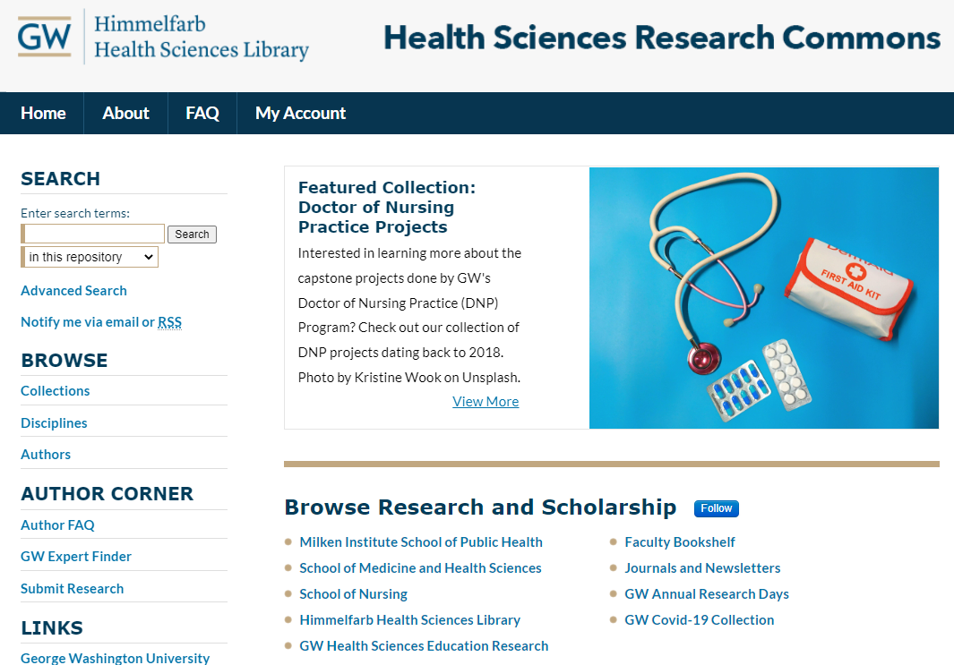
Digital Commons @ Himmelfarb
2012: Himmelfarb acquires Digital Commons (Health Sciences Research Commons/HSRC)
Uses:
Archiving full-text non-traditional/grey literature (policy briefs, conference posters, ETDs, etc.)
Citation archiving for faculty publications
Numbers: ~42,000 entries; ~875,000 total downloads/~177,000 downloads last year
Health Sciences Research Commons. https://hsrc.himmelfarb.gwu.edu/

Slide 7
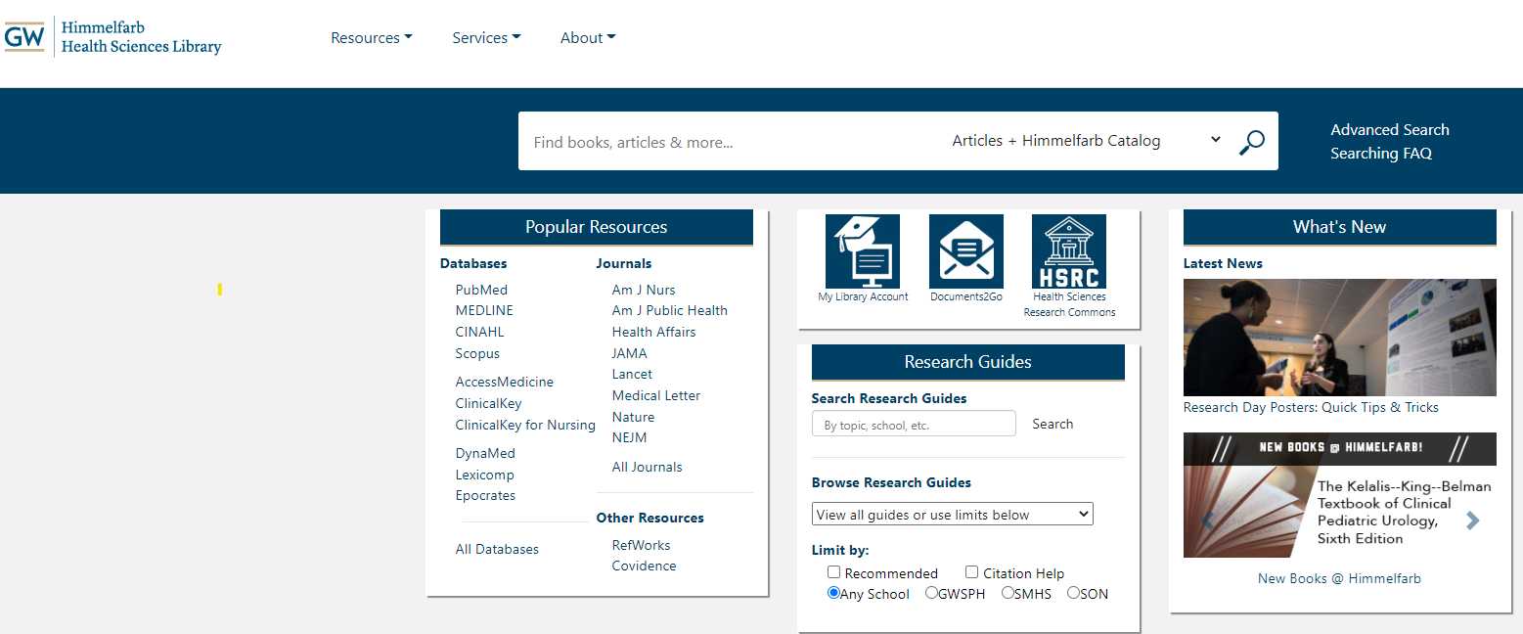
Alma/Primo VE @ Himmelfarb
2018: Himmelfarb Health Sciences Library joined the Washington Research Library Consortium (WRLC)
WRLC migrated to Ex Libris’ library service platform (Alma) and discovery service (Primo VE)
Himmelfarb Health Sciences Library. https://himmelfarb.gwu.edu/

Slide 8
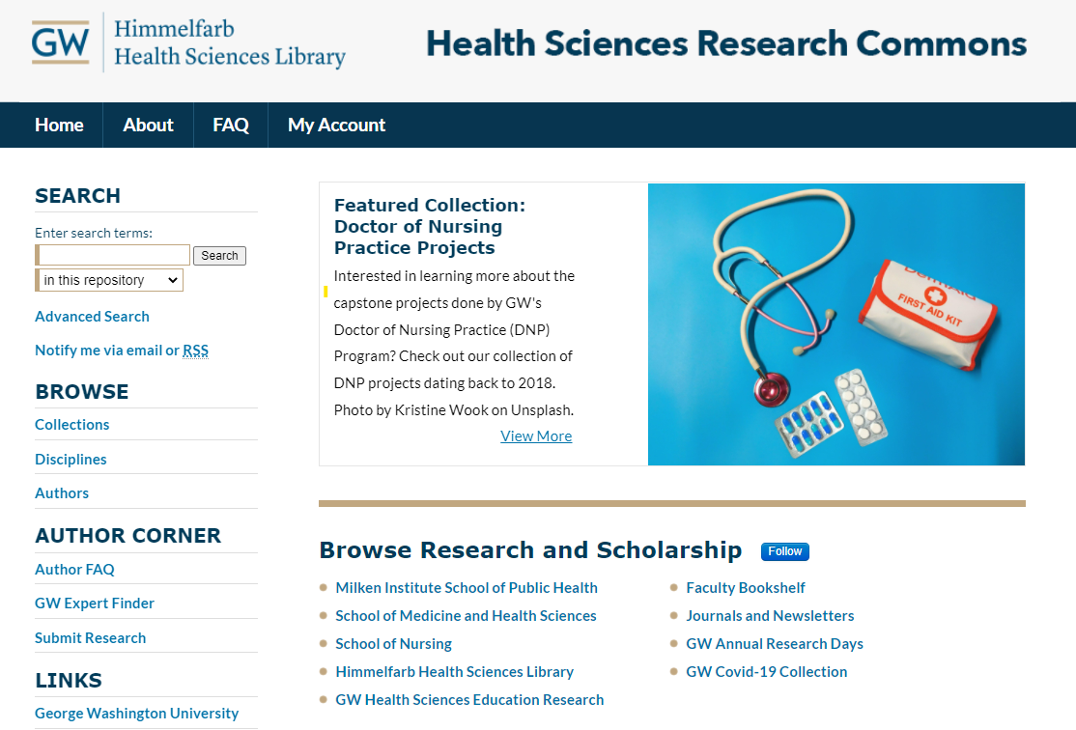
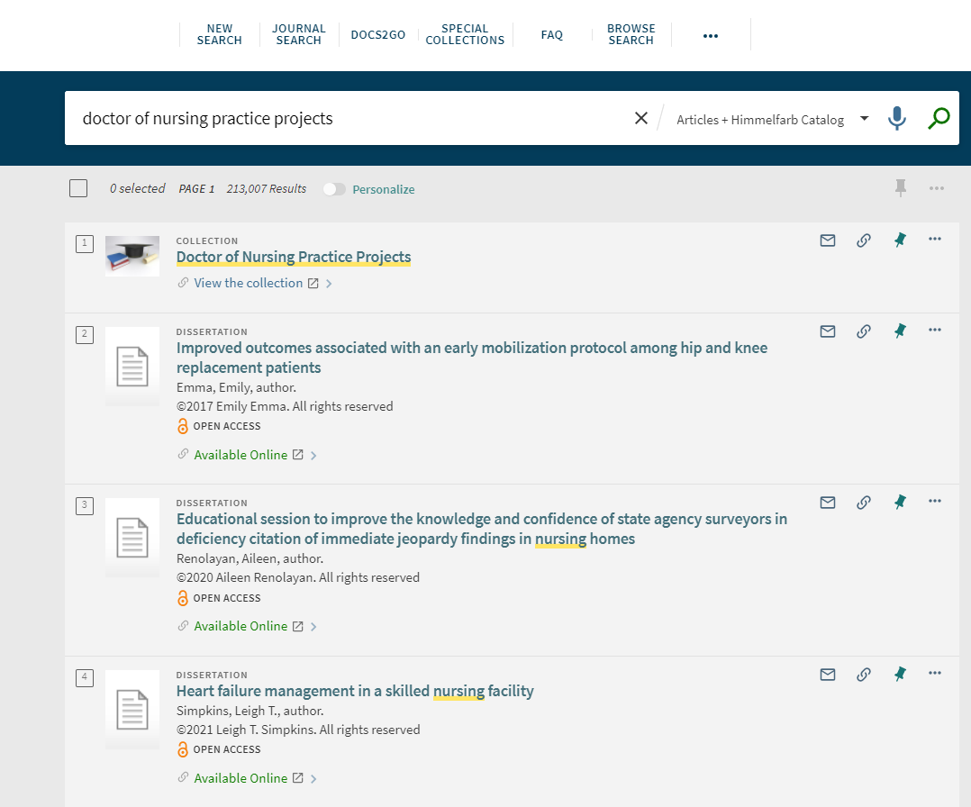
Our Question
Does content from an institutional repository (IR) have a place in a library catalog and if so, what are best practices for adding content?
Doctor of Nursing Practice projects. https://himmelfarb.gwu.edu/
Health Sciences Research Commons.
https://hsrc.himmelfarb.gwu.edu/

Slide 9
Answer: Yes!*
Despite the diminishing role of discovery services in the academic library marketplace (Breeding, 2021), the library catalog is still a potentially important avenue for discovery
Inclusion in a discovery systems helps to advance the dissemination of quality, institution specific content
Greater discovery within an institution = potential collaborations
Address practice gaps that can improve patient safety/improve the quality of healthcare (Kesten et al., 2021)
Growing body of literature highlights the importance of grey literature in health sciences research (Hoffecker, 2020; Kingsley, 2020; Pappas & Williams, 2011)

Slide 10
What type of content to add?
Full-text
Open Access
High-quality (associated review process)
Often not published elsewhere
Address gaps in the published literature

Slide 11
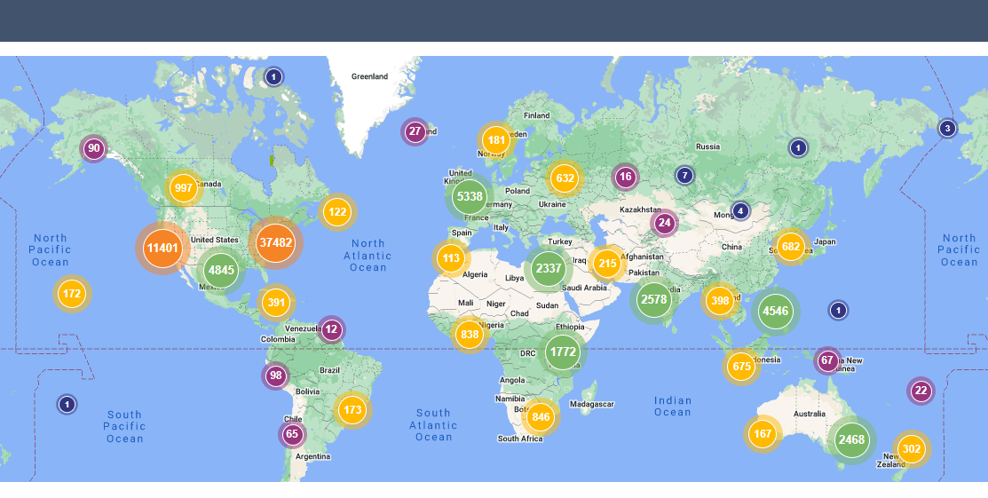
DNP Project Collection in Digital Commons
Established in 2017
Includes 103 projects
Over 82,000 total downloads/over 30,000 in the past year
High-quality content that is not always published
Health Sciences Research Commons. Doctor of Nursing Practice Projects Readership Distribution. 10/16/2027 to 04/1/2022

Slide 12
Dissemination of DNP Projects via OA Repositories
Need to disseminate practice scholarship outcomes in real-time, particularly in acute and primary care settings (AACN, 2018)
Open access repositories provide a unique platform for quickly disseminating content
Does linking an OA repository DNP collection to a library discovery system help to improve the dissemination of information?

Slide 13
Options for adding DNP projects to the library discovery system?
https://pixabay.com/illustrations/question-mark-question-response-1019935/

Slide 14
Possible Integration Strategies
OAI-PMH feed (Open Archives Initiative/Protocol for Metadata Harvesting) = Add all IR content
System Import Profiles = Add selected IR content (batch)
Manually create and add records = Add selected content (individual)

Slide 15
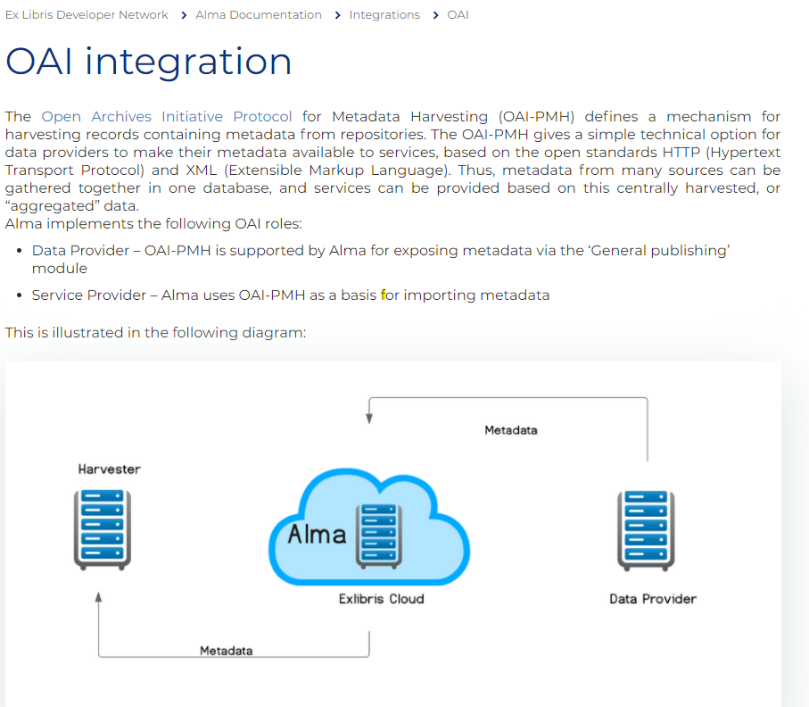
Solution 1: OAI-PMH feed
OAI-PMH compliant archive content can be included in Primo’s Central Index
Summer 2018: OAI-PMH feed was established between our instance of Digital Commons and Primo VE
Records were loaded into PCI (now CDI) on a weekly basis
Ex Libris. OAI integration. https://developers.exlibrisgroup.com/alma/integrations/oai/

Slide 16
Limits of the OAI-PMH Feed
Citation only IR entries linking to the catalog made for duplicative content in Primo VE
Reference librarians disliked prominence of grey literature such as conference posters in the library catalog
Can’t edit records manually
Feed was ultimately discontinued
http://clipart-library.com/

Slide 17
Solution 2: Batch adding content (Project Scope)
Extract Content from our institutional repository (Digital Commons)
Add content to our discovery system (Alma/Primo VE)
Benchmarking/Assess Usage

Slide 18
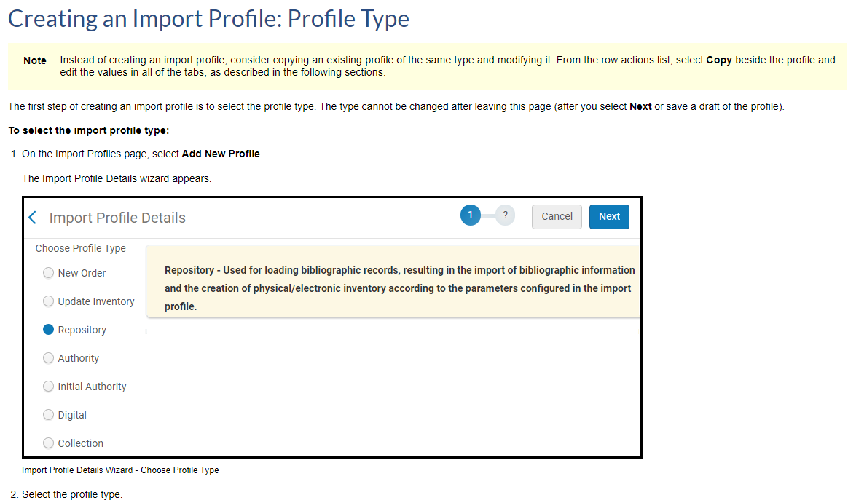
Step 1: Adding Content to Discovery System
Ex Libris = extensive documentation on Managing Import Profiles
Identify system import profile for batch adding content
Ex Libris. Creating an Import Profile: Profile Type. https://knowledge.exlibrisgroup.com/Alma/Product_Documentation/010Alma_Online_Help_(English)/040Resource_Management/060Record_Import/020Managing_Import_Profiles#Creating_an_Import_Profile:_Profile_Type

Slide 19
Step 2: Batch harvesting content from our institutional repository
Collection metadata can be exported via a content inventory report (Excel spreadsheet), but no option to export into a specific metadata schema
MARC 21 records were needed for the Repository type Import Profile
Ultimately elected to map harvested metadata to MARC 21 bibliographic format

Slide 20
MARC 21 Fields
Created an XLSX file w/ 30 MARC 21 fields
856 useful for creating electronic inventory
506 allowed us to designate OA status within Primo VE
Designated “Dissertation” as the resource type in LDR

Slide 21
System Limits
Subject cataloging = wanted to use MeSH for better retrieval in our discovery system
Alma currently only supports the integration of a single 650 2$a field
Unable to designate a local 590$a field (special collection in Primo)
Not problematic for current project scope (IZ only), but may be less than ideal if records were shared at the consortium level (NZ)

Slide 22
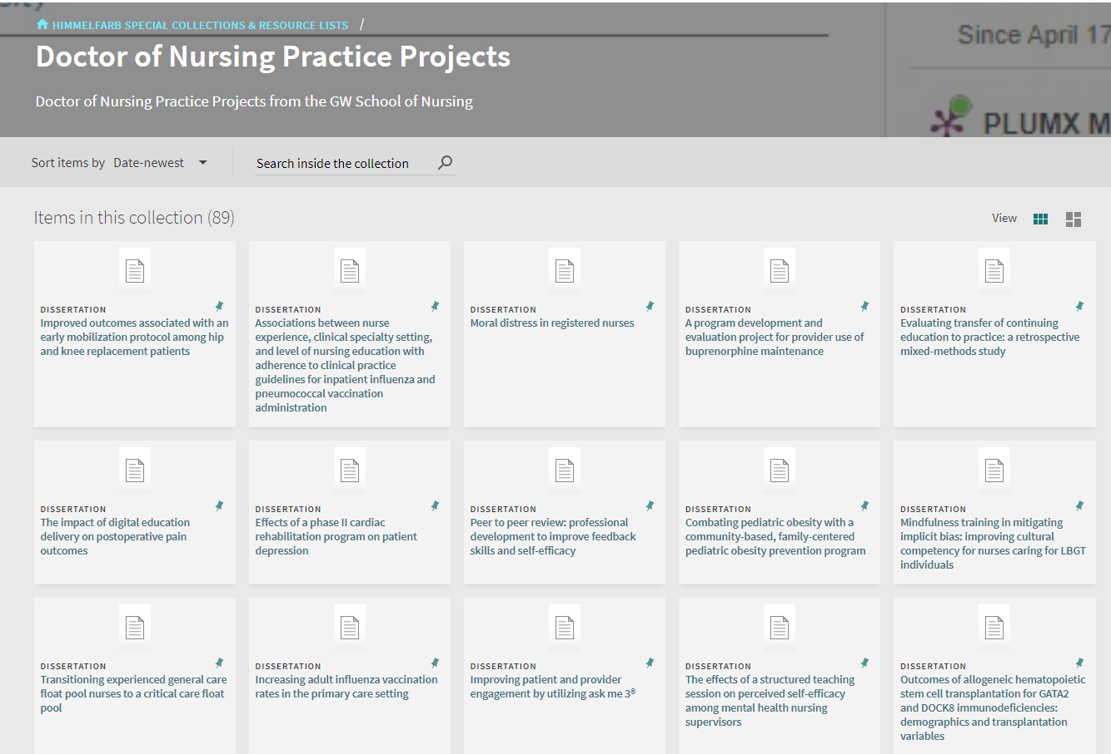
Step 3: Results
Ultimately created 89 bibliographic records in Alma via the Repository type Import Profile
Created a DNP project Special Collection in Primo VE
Over 500 link resolver requests since August 2021
Himmelfarb Health Sciences Library. Doctor of Nursing Practice Projects. https://wrlc-gwahlth.primo.exlibrisgroup.com/discovery/collectionDiscovery?vid=01WRLC_GWAHLTH:01WRLC_GWAHLTH&collectionId=8141600000004110

Slide 23
Project Benefits
Now have a workflow for mapping additional collections from Digital Commons into Alma/Primo VE
Now have a method for greater control over records within our discovery system than we had with the OAI-PMH feed
Established a method for batch rather than manual uploads
Increased interoperability between systems

Slide 24
Looking forward
Need for more research into benefits/problems with including OA content from an IR in a discovery systems
Need to explore user experience in finding and using content
What if any role do librarians play in helping to improve readership for institution specific content?
Will new systems/emerging technologies change the landscape?

Slide 25
Thank You!!!
Questions??? Sara Hoover
Metadata and Scholarly Publishing Librarian,
The George Washington University
shoover@gwu.edu

Slide 26
References
American Association of Colleges of Nursing. (2018, March 26). Defining scholarship in academic nursing task force consensus position statement. https://www.aacnnursing.org/News-Information/Position-Statements-White-Papers/Defining-Scholarship-Nursing
Breeding, M. (2021). 2021 Library systems report. American Libraries, May 3, 2021, https://americanlibrariesmagazine.org/2021/05/03/2021-library-systems-report/
Doctor of Nursing Practice Projects Collection. Health Sciences Research Commons. Retrieved 7 April 2022 from https://hsrc.himmelfarb.gwu.edu/son_dnp/
Doctor of Nursing Practice Projects Collection. Himmelfarb Special Collections & Resources List. Retrieved 7 April 2022 from https://wrlc-gwahlth.primo.exlibrisgroup.com/discovery/collectionDiscovery?vid=01WRLC_GWAHLTH:01WRLC_GWAHLTH
Hoffecker. (2020). Grey Literature Searching for Systematic Reviews in the Health Sciences. The Serials Librarian, 79(3-4), 252–260. https://doi.org/10.1080/0361526X.2020.1847745
Ex Libris. Managing Import Profiles. Retrieved 7 April 2022 from https://knowledge.exlibrisgroup.com/Alma/Product_Documentation/010Alma_Online_Help_(English)/040Resource_Management/060Record_Import/020Managing_Import_Profiles
Kesten, K. Moran, K., Beebe, S., Conrad, D., Burson, R., Corrigan, C., Manderscheid, A. & Pohl, E. (2021). Drivers for seeking the DNP degree and competencies acquired as reported by nurses in practice, Journal of the American Association of Nurse Practitioners, DOI 10.1097/JXX.0000000000000593 (published ahead of print)
Kingsley, D. (2020). The “Impact Opportunity” for Academic Libraries through Grey Literature. The Serials Librarian, 79(3-4), 281–289. https://doi.org/10.1080/0361526X.2020.1847744
Pappas, C. & Williams, I. (2011). Grey Literature: Its Emerging Importance. Journal of Hospital Librarianship, 11(3), 228–234. https://doi.org/10.1080/15323269.2011.587100

