Slide 1
The Post-Pandemic IR: Growing, Integrating, and Sharing Your Digital Commons Content
Sara Hoover, MLIS
Metadata and Scholarly Publishing Librarian
Himmelfarb Health Sciences Library
The George Washington University

Slide 2
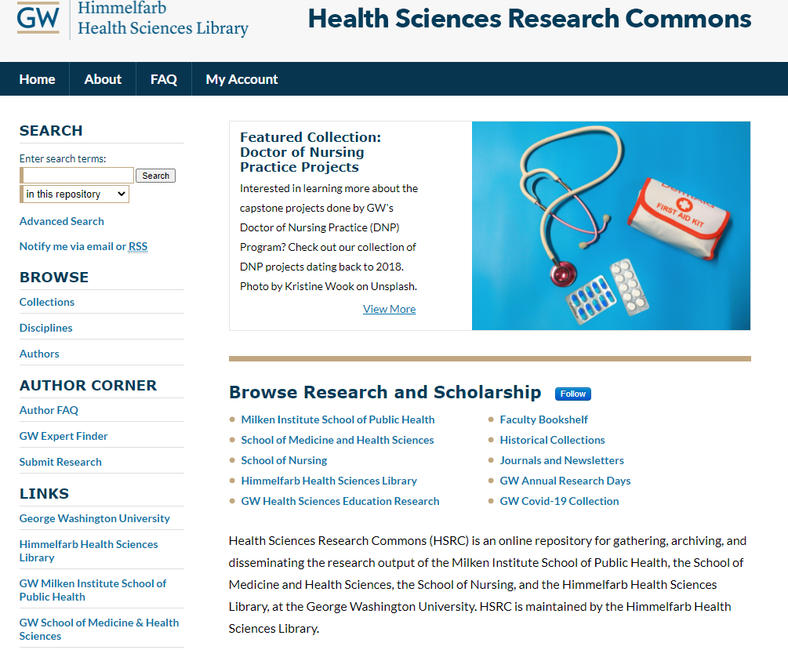
Health Sciences Research Commons: Background
Established in 2012 (https://hsrc.himmelfarb.gwu.edu/)
Includes content from the GW School of Medicine and Health Sciences, Milken Institute School of Public Health, and School of Nursing
Numbers: ~41,000 full text works; ~780,000 downloads; ~593,000 page hits
Collections: GW Research Days, Himmelfarb Health Sciences library, departmental publications, departmental posters/presentations, dissertations, and more

Slide 3
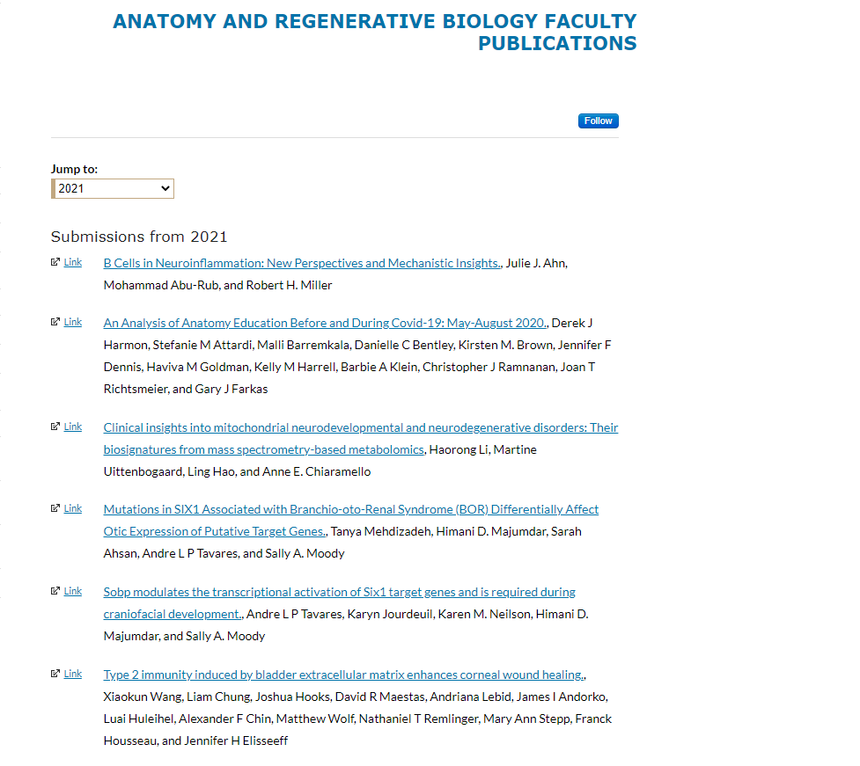
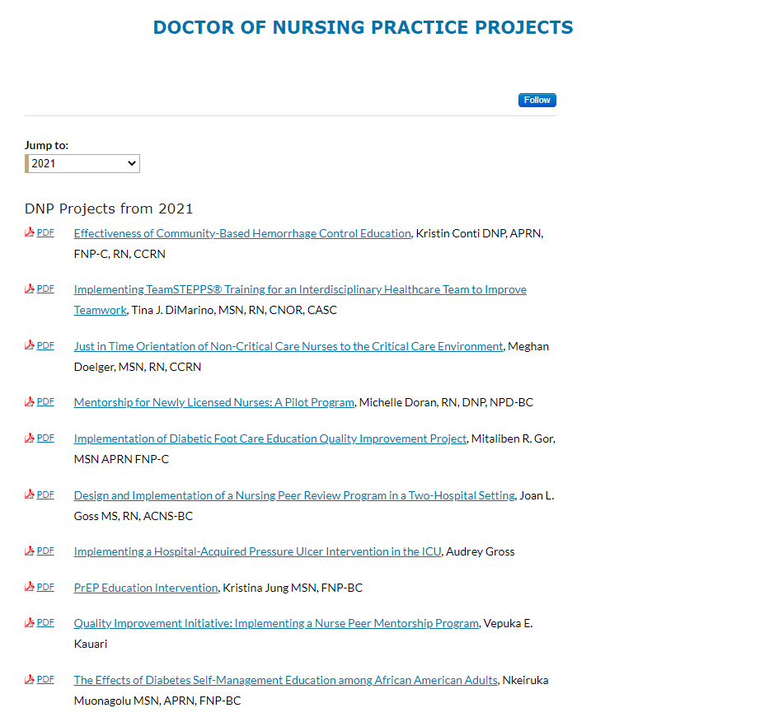
Pre-pandemic IR Uses: Full-text OA & Linked Faculty Publications Collections

Slide 4
Pandemic and Post-Pandemic IR Expansion
Use of new Digital Commons Harvesting Tools to expand faculty publication collections that link to library resources; inclusion of more full-text items
2019: 6,328 works posted; 69,569 page hits; 84,884 downloads
2020: 14,665 works posted; 118,411 page hits; 136,542 downloads
Integration of the Doctor of Nursing Practice project collection into the library’s discover system (Ex Libris Alma/Primo) for more targeted searching
Use of Event Communities Structure to create a website for a multi-institution symposium (Medical Institutional Repositories in Libraries)

Slide 5
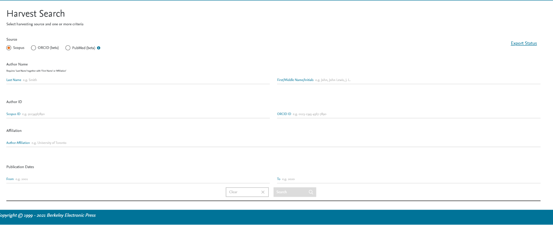
Growth: Database Harvesting
ORCiD
PubMed
Scopus
Why all 3? Scope of materials included, option for self-reporting, inclusion of materials outside of medicine

Slide 6
Integration: Digital Commons to Ex Libris Alma/Primo
Alma allows content from OAI-PMH compliant archives to be loaded to Primo for discovery and a feed was established in 2018
Discovered issues with inclusion of the full feed (i.e. items without full-text, etc.) and discontinued use
Goal: Identify strategies for harvesting and integrating specific collections into our library discovery system for specialized and targeted readership.
Selected Doctor of Nursing Practice project collection (full-text; high quality; unpublished elsewhere).
Used the Ex Libris Repository type Import Profile to map IR content to MARC 21 Bibliographic record and upload to Alma

Slide 7
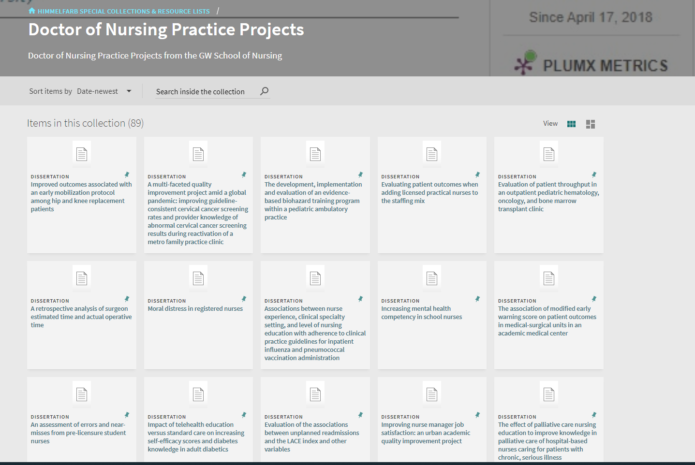
Digital Commons vs. Primo: DNP Project Collection

Slide 8
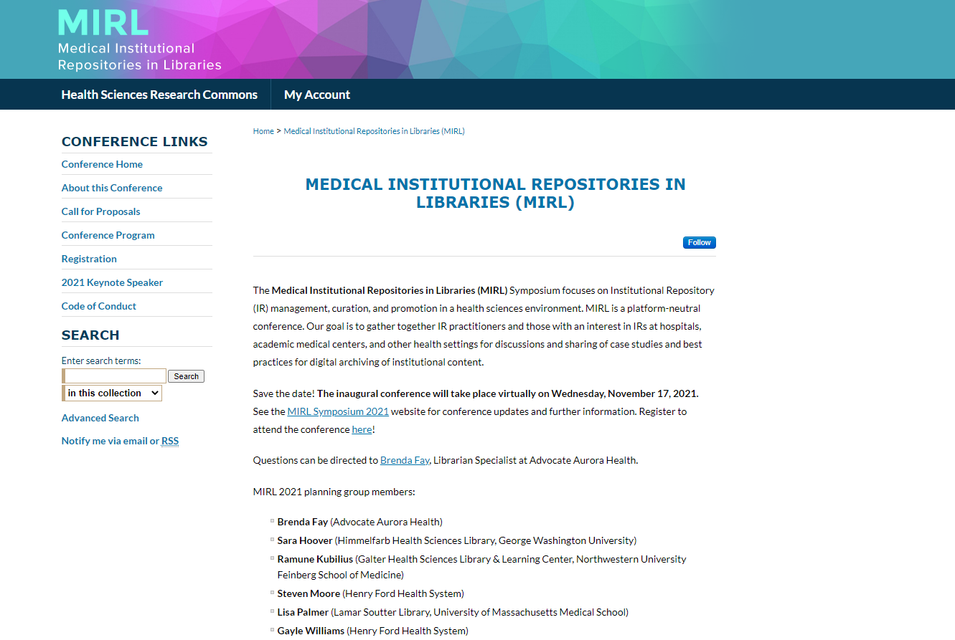
Sharing: The Medical Institutional Repositories in Libraries (MIRL) Symposium Website
Growth of smaller, more specific conferences type events
Digital Commons = effective platform for conference/symposium websites
Medical Institutional Repositories in Libraries (MIRL) 2021 (https://hsrc.himmelfarb.gwu.edu/mirl/ )

Slide 9
Looking Forward
Use of harvesting tools to ensure that all faculty publications are included in departmental collections
Growth of full-text OA content
Integration of selected IR collections into library discovery system (particularly grey literature)
Continued use of the IR for conference/symposium type events such as Medical Institutional Repositories in Libraries (MIRL) 2021

Slide 10
Thank You!

